Slide 1

How to Deal with Hyperinflation?
Presented BY : mASTERmiND Institute of studies

Slide 2
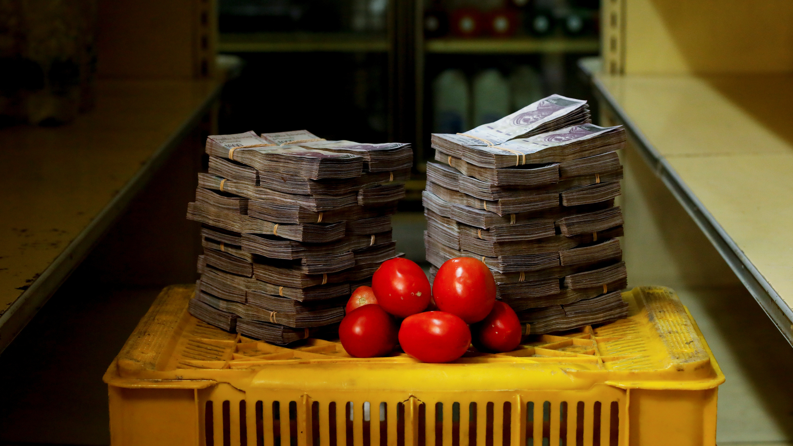
How to Deal With Hyperinflation
Hyperinflation is defined as an economic phenomenon in which rapid inflation leaves a country's currency virtually worthless. It is so destructive to investors and consumers that it should be regarded with the same concern and precaution sensible people take for natural disasters.
Severe hyperinflation degrades and eventually extinguishes market confidence in a currency as a legitimate method of measuring or maintaining the value of assets. Given the economic mayhem and societal turmoil that hyperinflation could engender, it is important to take both economic and practical steps to hedge against the risk of hyperinflation.

Slide 3
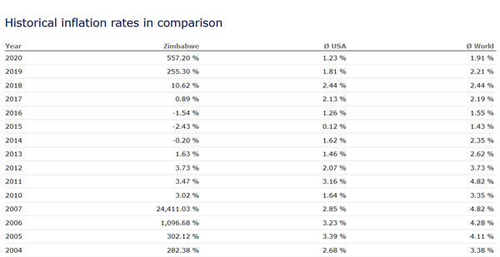
Zimbabwe Inflation 2005-2020

Slide 4
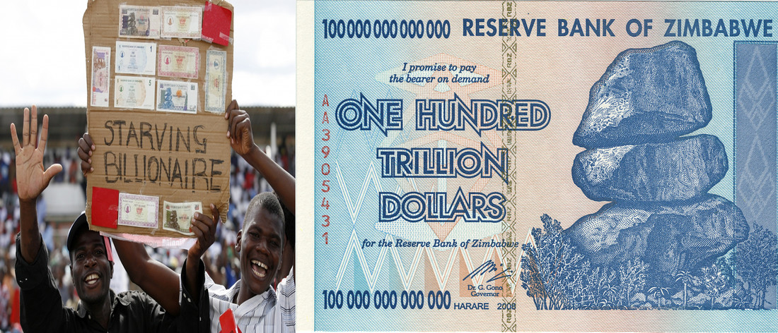
Starving BILLIONAIRES

Slide 5
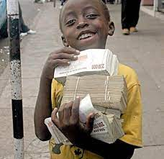
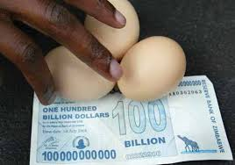
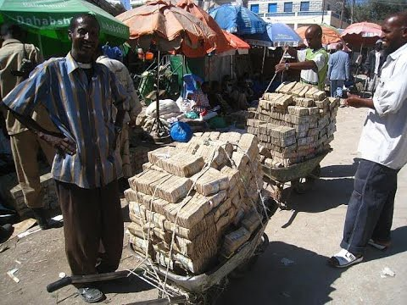
Starving BILLIONAIRES

Slide 6
Top 10 Countries with the Highest Inflation Rates (Trading Economics Jan 2022)
Venezuela — 1198.0%
Sudan — 340.0%
Lebanon — 201.0%
Syria — 139.0%
Suriname — 63.3%
Zimbabwe — 60.7%
Argentina — 51.2%
Turkey — 36.1%
Iran — 35.2%
Ethiopia — 33.0%

Slide 7
How to Deal With Hyperinflation
Step 1
Ensure that your investment portfolio includes assets that retain their value during a period of hyperinflation.
When a currency experiences hyperinflation, its value is destroyed by rising commodity and mineral prices, as sellers will not accept less value in exchange for their commodity. Accordingly, prices of oil, and minerals like gold and silver will rise to retain their intrinsic value.
Similarly, real estate often retains its value, though reduced economic activity may mean that a inflation-adjusted price is not as high as the appraised price prior to hyperinflation.

Slide 8
How to Deal With Hyperinflation
Step 2
Hedge against hyperinflation in your home currency by diversifying your assets into other strong currencies issued by politically stable jurisdictions. For example, the American dollar, the euro, the Japanese yen, and British pound are all considered strong currencies.
While hyperinflation in a country with significant trading relationships would likely have spill-over effects in the interconnected global economy, it is often a phenomenon experienced by one currency. (Ex:Indian Rupee)

Slide 9

How to Deal With Hyperinflation
Step 3
Devise contingency plans for the necessities you most often buy. Economist John Williams recommends that consumers should stock up on nonperishable foods such as canned items as a hedge against societal chaos under hyperinflation. Some experts also suggest that you learn to farm.

Slide 10
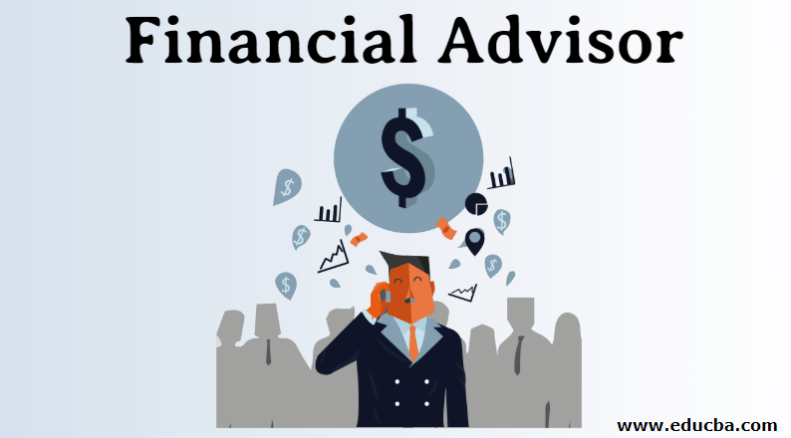
How to Deal With Hyperinflation ?
Tip
Consult investment advisers who specialize in complex asset classes prior to making any investments. Asset classes like commodities, Foreign Currencies, Stocks, GOLD, minerals and rare gems that retain their value in periods of hyperinflation also carry significant risks due to their investor ignorance and limited liquidity.

Slide 11
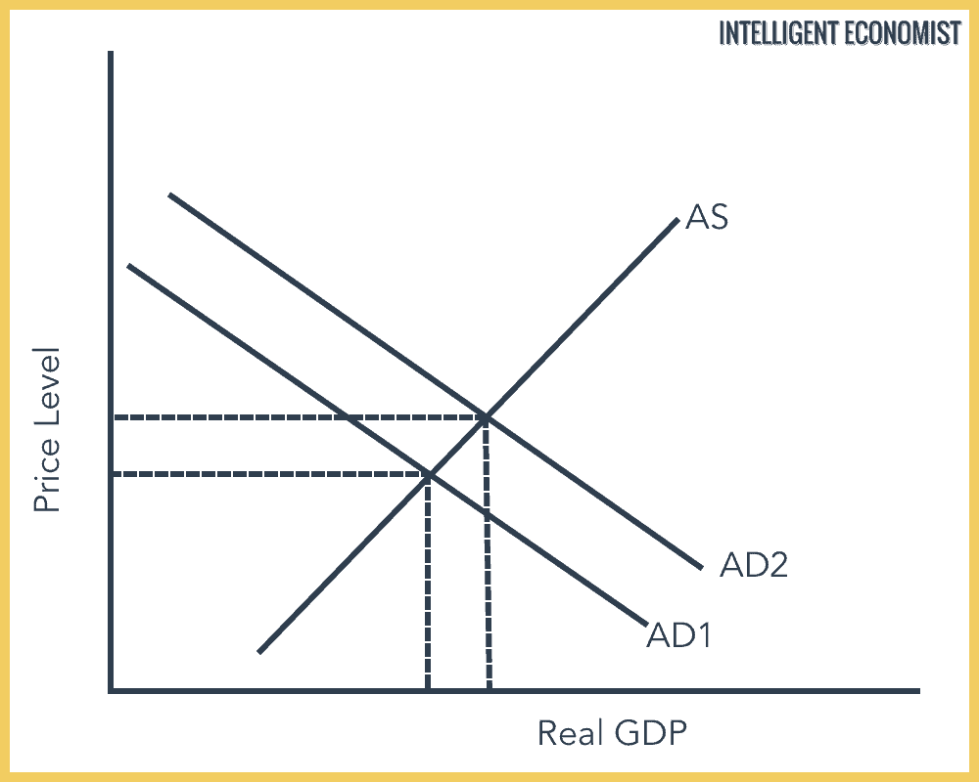
Demand-pull inflation
Occurs when the demand for goods and services—in other words, the overall amount of money and/or credit people have to spend—increases quicker than the economy’s production capacity.
Demand is high but supply can't keep up, so prices rise. The rising prices cause some buyers to drop out of the market, which decreases demand and reestablishes the balance between demand and supply.

Slide 12
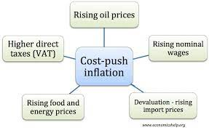
Cost-push inflation
Occurs as a result of the increase in the cost of production. For example, if the raw materials used to create a product increase in price, the price for the final good rises as producers pass their costs on to the consumer.

Slide 13
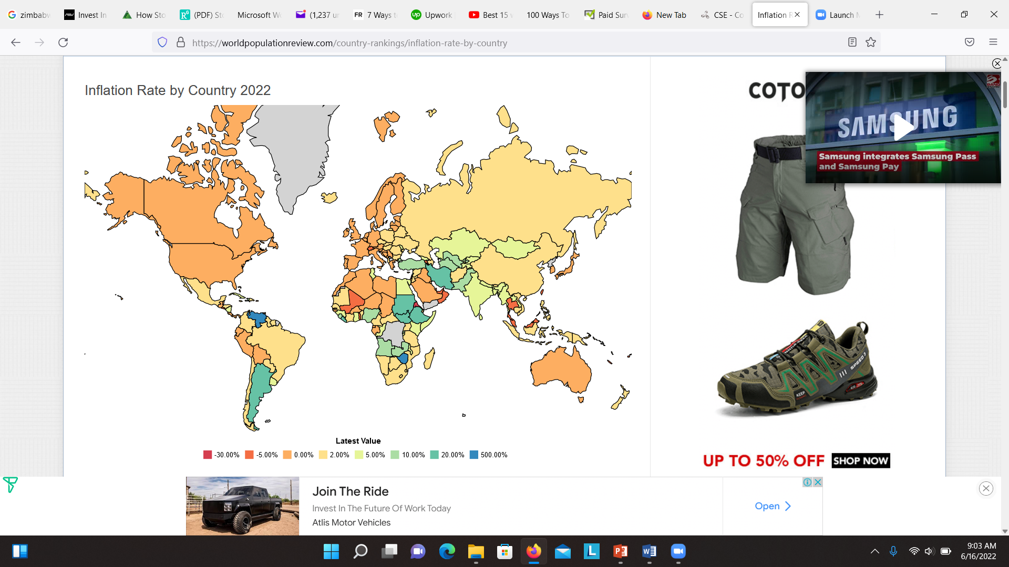

Slide 14

Ask these questions before starting
Why do you want to do this?
Do you have a passion?
Do you have skills to offer to people?
Can you write well?
Will you enjoy writing?
Are you disciplined?

Slide 15

7 Best Ways to Make Money Online in Sri Lanka
Start a blog. Learn how to build your own blog and first gain the skills. ...
Offer Freelancing Services. ...
Become a YouTuber. ...
Earn money with Affiliate marketing. ...
Work for an overseas company online. ...
Start an eCommerce Store. ...
Stock Market Investing & Trading / Crypto

Slide 16
Offer Freelancing Services
Do you have a skill like graphic designing?
Can you create websites?
If not you can learn the skills in 6 months to 12 months.
Yes, you must invest the time and take a course and learn the skills.
Can you write content?
There are many places like UpWork, People Per Hour where you can offer your services.
Taste the freelancing money via Fiverr.
There are many sites online you can join for free and offer your services,
One of the best skills you can learn is SEO.
Case Study
I learned SEO and started offering freelance SEO services to business owners.
SEO is one of the highest demanding skills and if you are smart, you can learn SEO.

Slide 17
How to Profit From Inflation?
Several asset classes perform well in inflationary environments.
Tangible assets, like real estate and commodities, have historically been seen as inflation hedges.
Some specialized securities can maintain a portfolio's buying power including certain sector stocks, inflation-indexed bonds, and securitized debt.
Inflation-sensitive investments are accessed in a variety of ways as both direct and indirect investments.

Slide 18
How to Profit From Inflation?
How Inflation Affects Asset Values
Inflation is most damaging to the value of fixed-rate debt securities, because it devalues interest rate payments as well repayments of principal. If the inflation rate exceeds the interest rate, lenders are in effect losing money after adjusting for inflation. This is why investors sometimes focus on the real interest rate, derived by subtracting the inflation rate from the nominal interest rate.
Longer-term fixed rate debt is more vulnerable to inflation than short-term debt, because the effect of inflation on the value of future repayments is correspondingly greater, and compounds over time.
The assets that fare best under inflation are those assured of bringing in more cash or rising in value as inflation increases. Examples would include a rental property subject to periodic increases in rent or an energy pipeline charging rates tied to inflation.

Slide 19
How to Profit From Inflation?
Real Estate
Real estate is a popular choice because it becomes a more useful and popular store of value amid inflation while generating increased rental income.
Investors can buy real estate directly or invest in it by buying shares of a real estate investment trust (REIT) or specialized fund.
Real estate fared particularly well during an outbreak of persistent inflation during the 1970s.3 But real estate is also vulnerable to rising interest rates and financial crises, as seen in 2007-2008. And interest rate increases are the conventional monetary policy response to elevated inflation.

Slide 20
How to Profit From Inflation?
Commodities
When inflation picks up investors often turn to tangible assets likely to rise in value.
For centuries, the leading haven has been gold—and, to a lesser extent, other precious metals—causing price to rise as inflation rises. Gold can also be purchased directly from a bullion or con dealer or indirectly by investing in a mutual fund or exchange traded fund (ETF) that owns gold. Investors can also get exposure to a commodity by buying the shares of its producers directly or indirectly through an ETF or specialized mutual fund.
Many investments have been historically viewed as hedges—or protection—against inflation. These include real estate, commodities, and certain types of stocks and bonds.
Commodities include raw materials and agricultural products like oil, copper, cotton, soybeans, and orange juice. Commodity prices tend to rise alongside the prices of finished products made from those commodities in inflationary environments. For example, higher crude prices elevate the price of gasoline and transportation. Sophisticated investors can trade commodities futures or the shares of producers. On the other hand, exchange-traded funds investing in commodity futures will tend to underperform the price of a rising commodity, because their futures positions must be rolled as they expire

Slide 21
How to Profit From Inflation?
STOCKS / SHARES
Stocks have a reasonable chance of keeping pace with inflation—but when it comes to doing so, not all equities are created equal. For example, high-dividend-paying stocks tend to get hammered like fixed-rate bonds in inflationary times.13 Investors should focus on companies that can pass their rising input costs to customers, such as those in the consumer staples sector.

Slide 22


How to Invest In GOLD?

Slide 23

How to Make Money GOLD?
2001 = Rs 5200
2022= Rs 190,000
Gain in 20 Years = 3,538%

Slide 24
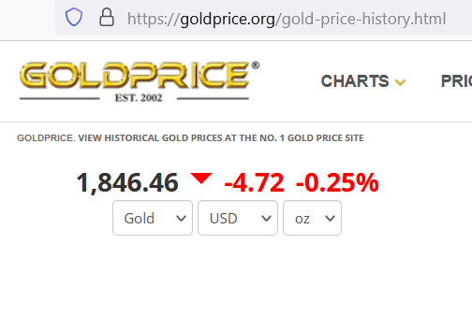
Price Movements In GOLD

Slide 25
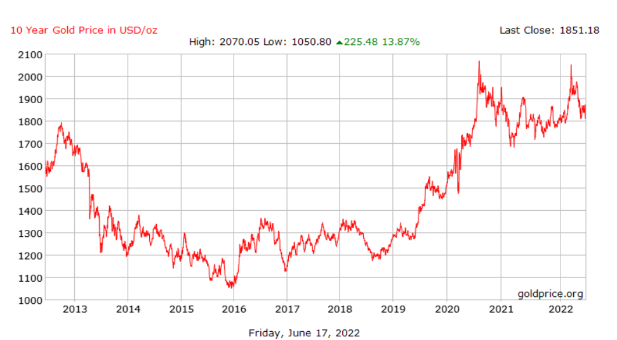
Price Movements In GOLD

Slide 26
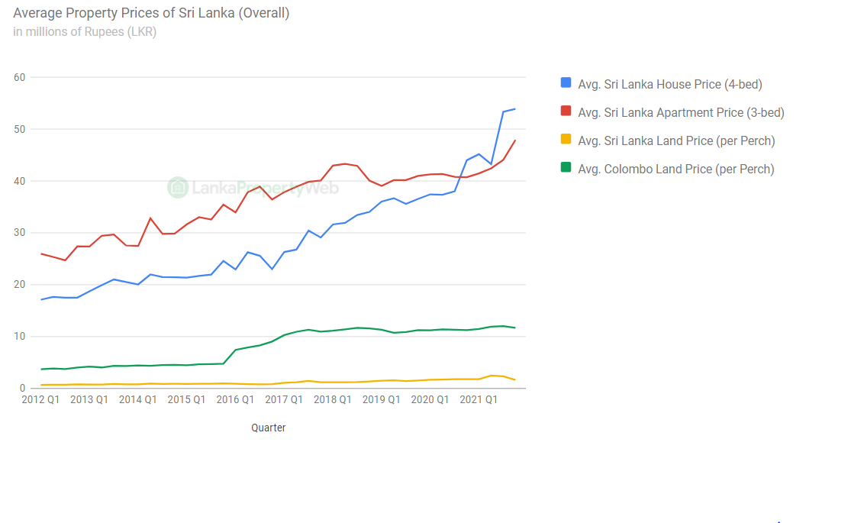
Real Estate

Slide 27
Real Estate JOB And Earning Opportunities
Prime Lands & Home Lands
Be Agent for 3 Customers
Real Estate Broker – Acquest https://www.acquest.lk/ (3%+)

Slide 28

Real Estate Broker – (3%+)
House for Sale Rs 35,000,000
Broker Commissions : 35,000,000*3%
= Rs 1,050,000

Slide 29

How to Earn USD??
FREELANCING
DIGITAL FILE
Payoneer –Online bank account USD
Adz Sense – International Audience
TWITCH –Live Stream www.twitch.tv
Sell Photos – shutterstock , istock, creativemarket.com, graphicviewer.com,

Slide 30

How to Earn USD?? Freelancing
www.fiverr.com
www.toptal.com
www.freelancer.com
www.upwork.com
www.guru.com
www.taskrabbit.com
www.upwork.com

Slide 31
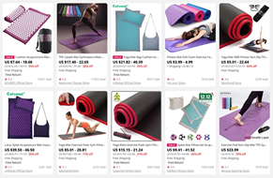
How to Earn USD?? SELL Physical Products
Redbubble.net
Sell items ; physical Products
www.ebay.com / Amozon (USD) www.etsy.com
Petrium WEB

Slide 32

How to Earn USD??
Tuition / Class :
www.udemy.com
www.stsy.com

Slide 33

How to Earn USD?? Remote JOBS
USD 3000 Software Engineers
www.linkedin.com
www.monster.com

Slide 34
Is There a Correlation Between Inflation and Home Prices?
There is a correlation between inflation and house prices. In fact, there are correlations between inflation and any good with a limited supply. To illustrate, consider an economy that has a money supply of only $10 and five identical houses in the whole economy. Each house would be priced at $2 (assuming no other goods in the economy). Now, suppose the central bank decides to print more money and the money supply expands to $20. Now each house would be priced at $4. In this simplistic example, increasing the money supply causing inflation and house prices to increase.
In the real economy, there are a lot more factors that affect house prices and the correlation is not as prominent as in our example. One of the other major factors causing house prices to increase is interest rates. When interest rates are low, buying homes can be more affordable and increase the demand for homes. If the supply of homes remains constant and the demand increases, then the prices of homes will increase. In large cities where land availability is often limited, you can see a more pronounced effect of inflation.

Slide 35
What is the relationship between benchmark interest rates and inflation?
Interest rates and inflation tend to move in the same direction because the benchmark interest rate is one of the monetary policies used by apex banks to control money supply, inflation and maintain price stability. Any change in the quantity of money produces exactly proportionate change in the price level.
By reducing interest rates, businesses can borrow and have funds at a cheaper rate, thus reducing their cost of funds, which will in turn reduce finance costs and increase profitability.
In contrast, by increasing benchmark interest rates, the level of risk-free reserves in the financial system is increased, limiting the money supply available for purchases of riskier assets. Borrowing cost is increased, limiting consumer and business consumption and spending.
In regards to investment markets, higher interest rates typically decrease the value of expected future cash flows

Slide 36
Pros and Cons of Investing for Inflation
Pros
Preserve portfolio worth
Diversify holdings
Maintain income's buying power
Cons
Increase exposure to risk
Divert from long-term goals
Overweight portfolio in some classes

Slide 37

Best ways to make money online for free:
Become a virtual assistant
Do research online
Transcribe audio and video files
Set up a Patreon
Review websites and apps
Join an affiliate program
Launch a YouTube channel
Participate in focus groups
Become an online travel agent
Sell photos online
Offer social media consultancy

Slide 38

Best ways to make money online for free
100 ways : BONUS

Slide 39
You can find Us on
YouTube : MasterMind ROSHAN
FB Fan Page: MasterMind Roshan
LinkedIn : MasterMind Roshan
Instagram: MasterMind Roshan
Twitter : MasterMind Roshan

Slide 40

How to Contact ??
E-mail : mastermindclassroom@gmail.com
Call/ WhatsApp -076 5678784

Slide 41

THANK YOU

